Slide 1

Algorithms and Data Structures 2 CS 1501
Fall 2021
Sherif Khattab
ksm73@pitt.edu
(Slides are adapted from Dr. Ramirez’s and Dr. Farnan’s CS1501 slides.)

Slide 2
Announcements
Upcoming deadlines:
4/19: Assignment 4
4/21: Homework 12
4/23: Lab 11
4/30: Lab 12
5/2: Assignment 5
5/2: Bonus Homework
Tophat questions are due one week after each lecture
OMETs
1 bonus point for entire class when response rate >= 80%
Currently at ~33%
Deadline is Sunday 4/25

Slide 3
Last lecture …
(Big)Integer Algorithms
exponentiation
GCD
Encryption

Slide 4
Integer multiplication
Say we have 5 baskets with 8 apples in each
How do we determine how many apples we have?
Count them all?
That would take a while…
Since we know we have 8 in each basket, and 5 baskets, lets simply add 8 + 8 + 8 + 8 + 8
= 40!
This is essentially multiplication!
8 * 5 = 8 + 8 + 8 + 8 + 8

Slide 5
What about bigger numbers?
Like 1284 * 1583, I mean!
That would take way longer than counting the 40 apples!
Let's think of it like this:
1284 * 1583 = 1284*3 + 1284*80 + 1284*500 + 1284*1000
1284
x 1583
3852
+ 102720
+ 642000
+ 1284000
= 2032572

Slide 6
OK, I’m guessing we all knew that...
… and learned it quite some time ago …
So why bring it up now? What is there to cover about multiplication
What is the runtime of this multiplication algorithm?
For 2 n-digit numbers:
n²
Notes:
What is the size of our input?
Note that as stated this is also n² space, but need not be

Slide 7
Yeah, but the processor has a MUL instruction
Assuming x86
Given two 32-bit integers, MUL will produce a 64-bit integer in a few cycles
What about when we need to multiply large ints?
VERY large ints?
RSA keys should be 2048 bits
Back to grade school…

Slide 8
Gradeschool algorithm on binary numbers
10100000100
x 11000101111
10100000100
101000001000
1010000010000
10100000100000
000000000000000
1010000010000000
00000000000000000
000000000000000000
0000000000000000000
10100000100000000000
101000001000000000000
111110000001110111100

Slide 9
How can we improve our runtime?
Let’s try to divide and conquer:
Break our n-bit integers in half:
x = 1001011011001000, n = 16
Let the high-order bits be x_{H} = 10010110
Let the low-order bits be x_{L} = 11001000
x = 2^{n/2}x_{H} + x_{L}
Do the same for y
x * y = (2^{n/2}x_{H} + x_{L}) * (2^{n/2}y_{H} + y_{L})
x * y = 2^{n}x_{H}y_{H} + 2^{n/2}(x_{H}y_{L} + x_{L}y_{H}) + x_{L}y_{L}

Slide 10
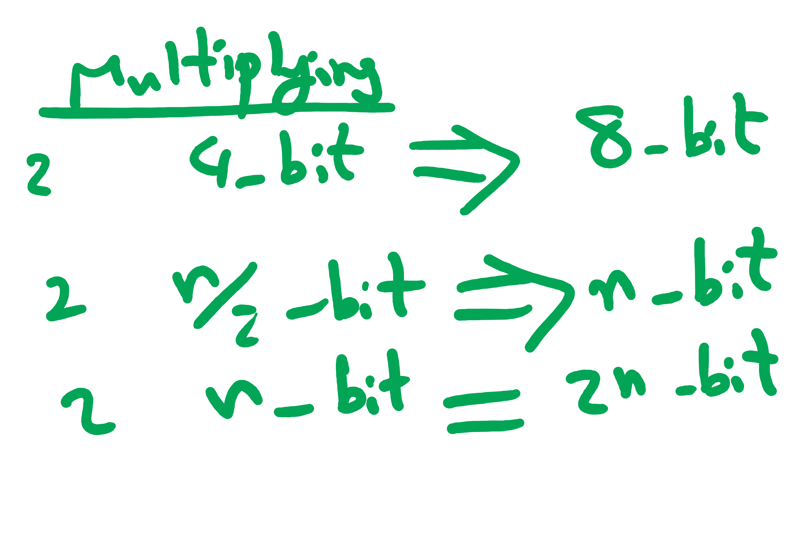
So what does this mean?
4 multiplications of n/2 bit integers
3 additions of n-bit integers
2^{n}x_{H}y_{H} + 2^{n/2}(x_{H}y_{L} + x_{L}y_{H}) + x_{L}y_{L}
A couple shifts of up to n positions
Actually 16 multiplications of n/4 bit integers
(plus additions/shifts)
Actually 64 multiplications of n/8 bit integers
(plus additions/shifts)
...

Slide 11
So what's the runtime???
Recursion really complicates our analysis…
We’ll use a recurrence relation to analyze the recursive runtime
Goal is to determine:
How much work is done in the current recursive call?
How much work is passed on to future recursive calls?
All in terms of input size

Slide 12
Recurrence relation for divide and conquer multiplication
Assuming we cut integers exactly in half at each call
I.e., input bit lengths are a power of 2
Work in the current call:
Shifts and additions are Θ(n)
Work left to future calls:
4 more multiplications on half of the input size
T(n) = 4T(n/2) + Θ(n)

Slide 13
Soooo… what’s the runtime?
Need to solve the recurrence relation
Remove the recursive component and express it purely in terms of n
A “cookbook” approach to solving recurrence relations:
The master theorem

Slide 14
The master theorem
Usable on recurrence relations of the following form:
T(n) = aT(n/b) + f(n)
Where:
a is a constant >= 1
b is a constant > 1
and f(n) is an asymptotically positive function
Notes:
Note this does NOT cover nearly all possible recurrence relations, just really handy for alot of them
We will need more different techniques for more problematic recurrences

Slide 15
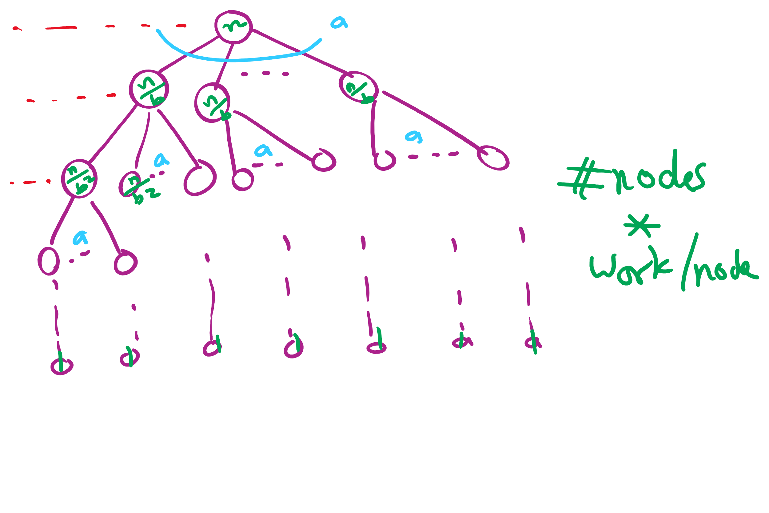
Recursion Tree

Slide 16
Applying the master theorem
T(n) = aT(n/b) + f(n)
If f(n) is O(n^{log_b(a) - ε}):
T(n) is Θ(n^{log_b(a)})
If f(n) is Θ(n^{log_b(a)})
T(n) is Θ(n^{log_b(a)} lg n)
If f(n) is Ω(n^{log_b(a) + ε}) and (a * f(n/b) <= c * f(n)) for some c < 1:
T(n) is Θ(f(n))
Notes:
T(n) = 2T(n/2) + n lg n
falls into a gap
n lg n is asymptotically larger than n, but not polynomially larger

Slide 17
Last lecture …
Max Flow implementation issues
Min Cut
(Big)Integer Algorithms
multiplication

Slide 18
Muddiest points
min cut
finding minimum st cut
Could you restate what a min cut is?
min st cut finding and duality, how does it equal max flow??
why to use min cut / max flow
Min cut implementation/actual code
Can you explain duality again?
Master Theorem
master theorem pros/cons
divide and conquer. Honestly, im very confused about the last 10 minutes content of today's lecture.
The tree of nodes at the end of the lecture
The big integer recurrence relations
Difference between recurrence relation and recursion tree and how to derive a recurrence relation

Slide 19
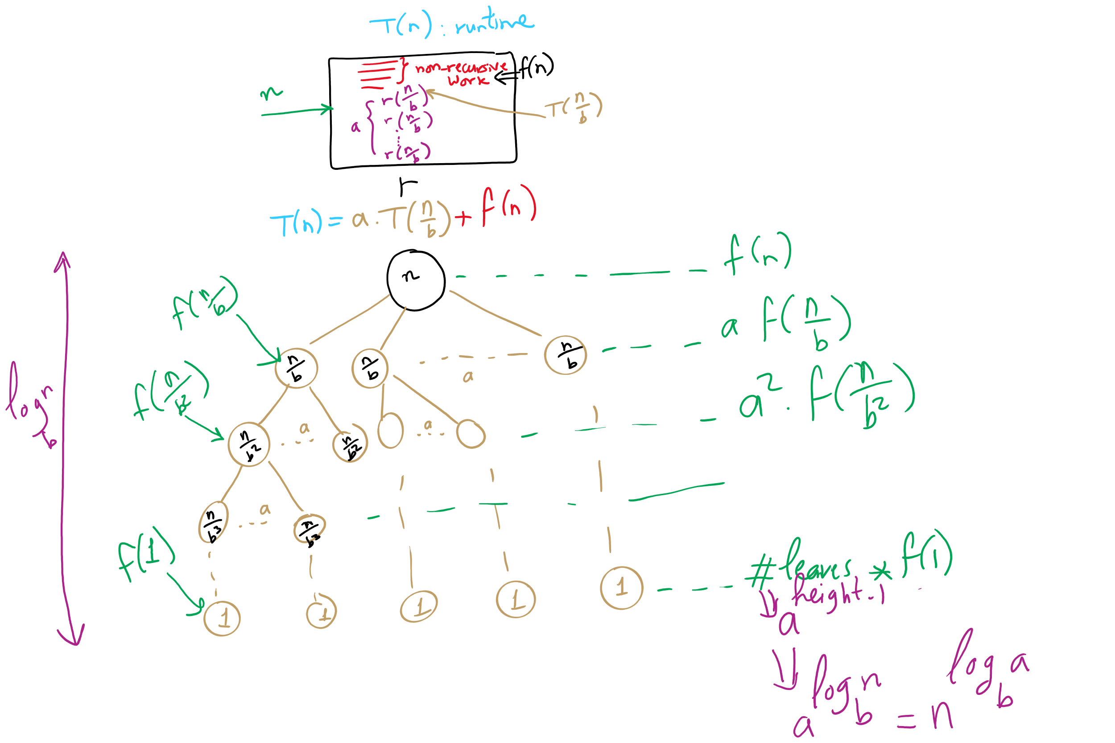
Recurrence vs. Recursion Tree

Slide 20
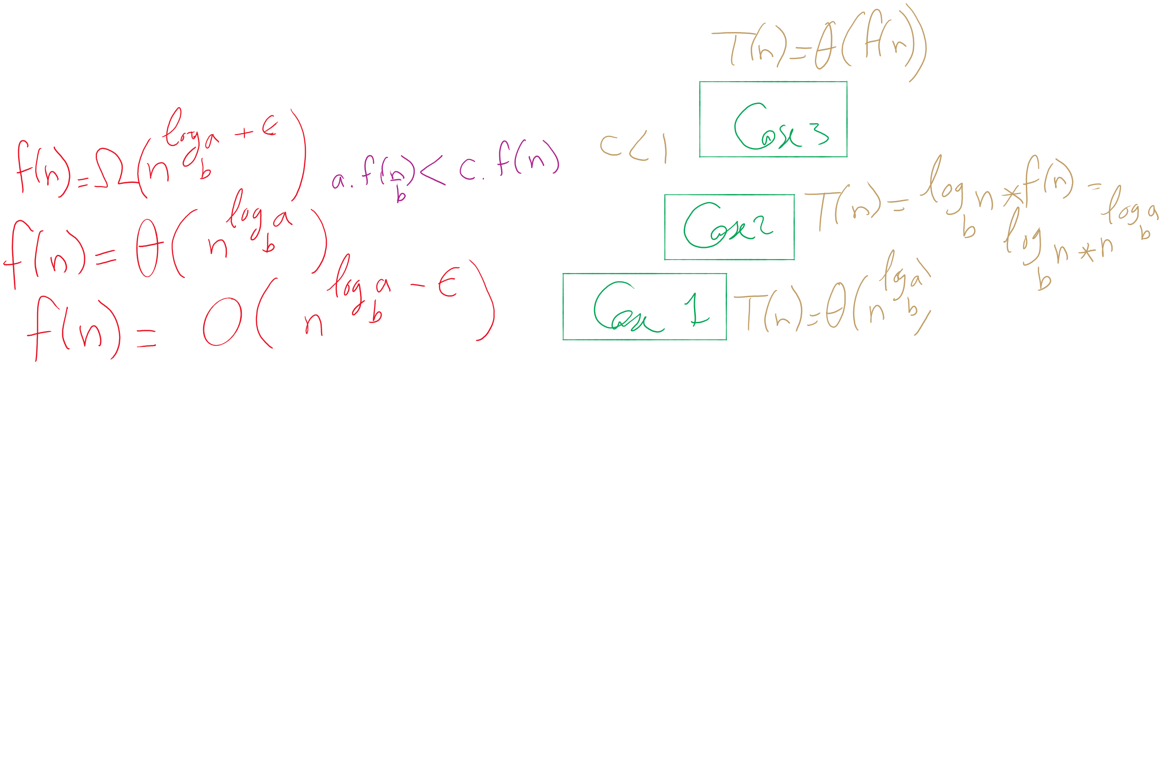

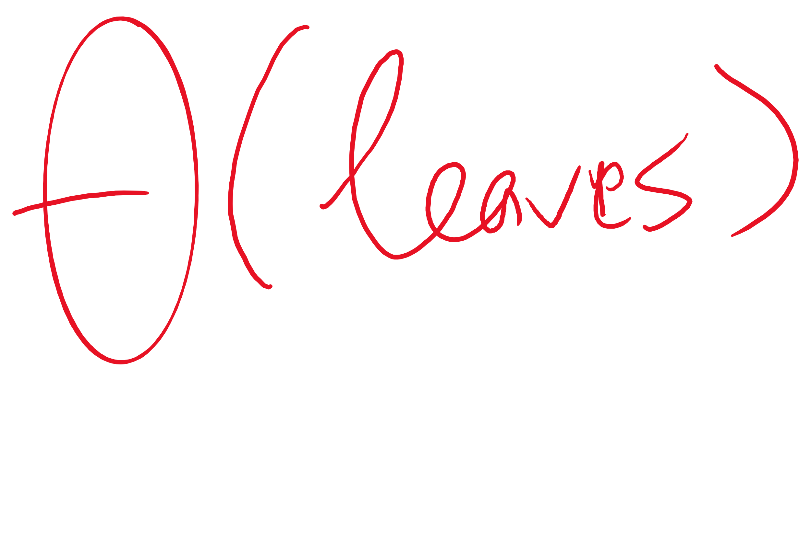
The 3 cases of the Master Theorem

Slide 21
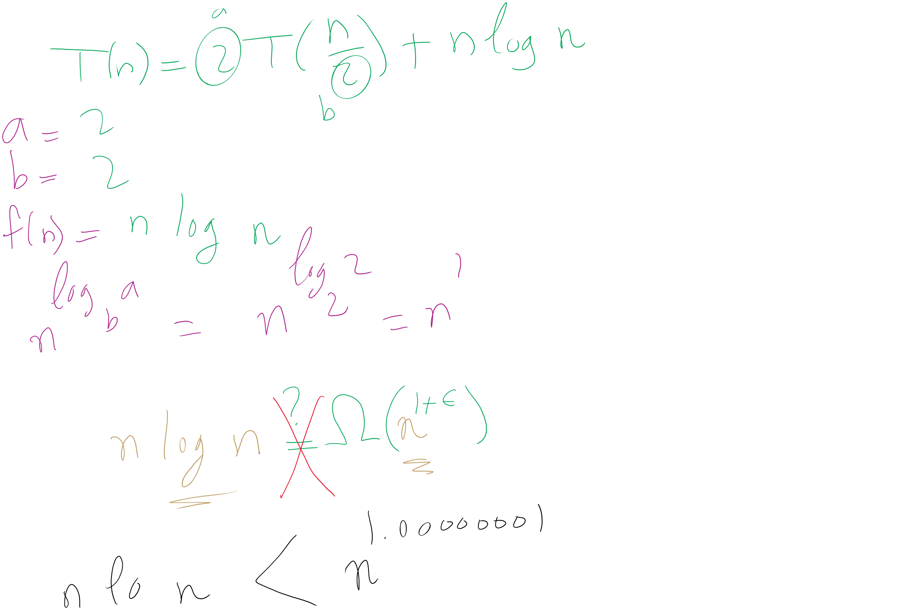
When Master Theorem doesn’t apply: Example

Slide 22
This Lecture
(Big)Integer Algorithms
Karatsuba multiplication
exponentiation
GCD
RSA encryption

Slide 23
Applying the master theorem
T(n) = aT(n/b) + f(n)
If f(n) is O(n^{log_b(a) - ε}):
T(n) is Θ(n^{log_b(a)})
If f(n) is Θ(n^{log_b(a)})
T(n) is Θ(n^{log_b(a)} lg n)
If f(n) is Ω(n^{log_b(a) + ε}) and (a * f(n/b) <= c * f(n)) for some c < 1:
T(n) is Θ(f(n))
Notes:
T(n) = 2T(n/2) + n lg n
falls into a gap
n lg n is asymptotically larger than n, but not polynomially larger

Slide 24
Mergesort master theorem analysis
Recurrence relation for mergesort?
T(n) = 2T(n/2) + Θ(n)
T(n) = 2T(n/2) + Θ(n)
If f(n) is O(n^{log_b(a) - ε}):
T(n) is Θ(n^{log_b(a)})
If f(n) is Θ(n^{log_b(a)})
T(n) is Θ(n^{log_b(a)} lg n)
If f(n) is Ω(n^{log_b(a) + ε}) and (a * f(n/b) <= c * f(n)) for some c < 1:
T(n) is Θ(f(n))
a = 2
b = 2
f(n) is Θ(n)
So...
n^{log_b(a)} = …
n^{lg 2} = n
Being Θ(n) means f(n) is Θ(n^{log_b(a)})
T(n) = Θ(n^{log_b(a)} lg n) = Θ(n^{lg 2} lg n) = Θ(n lg n)

Slide 25
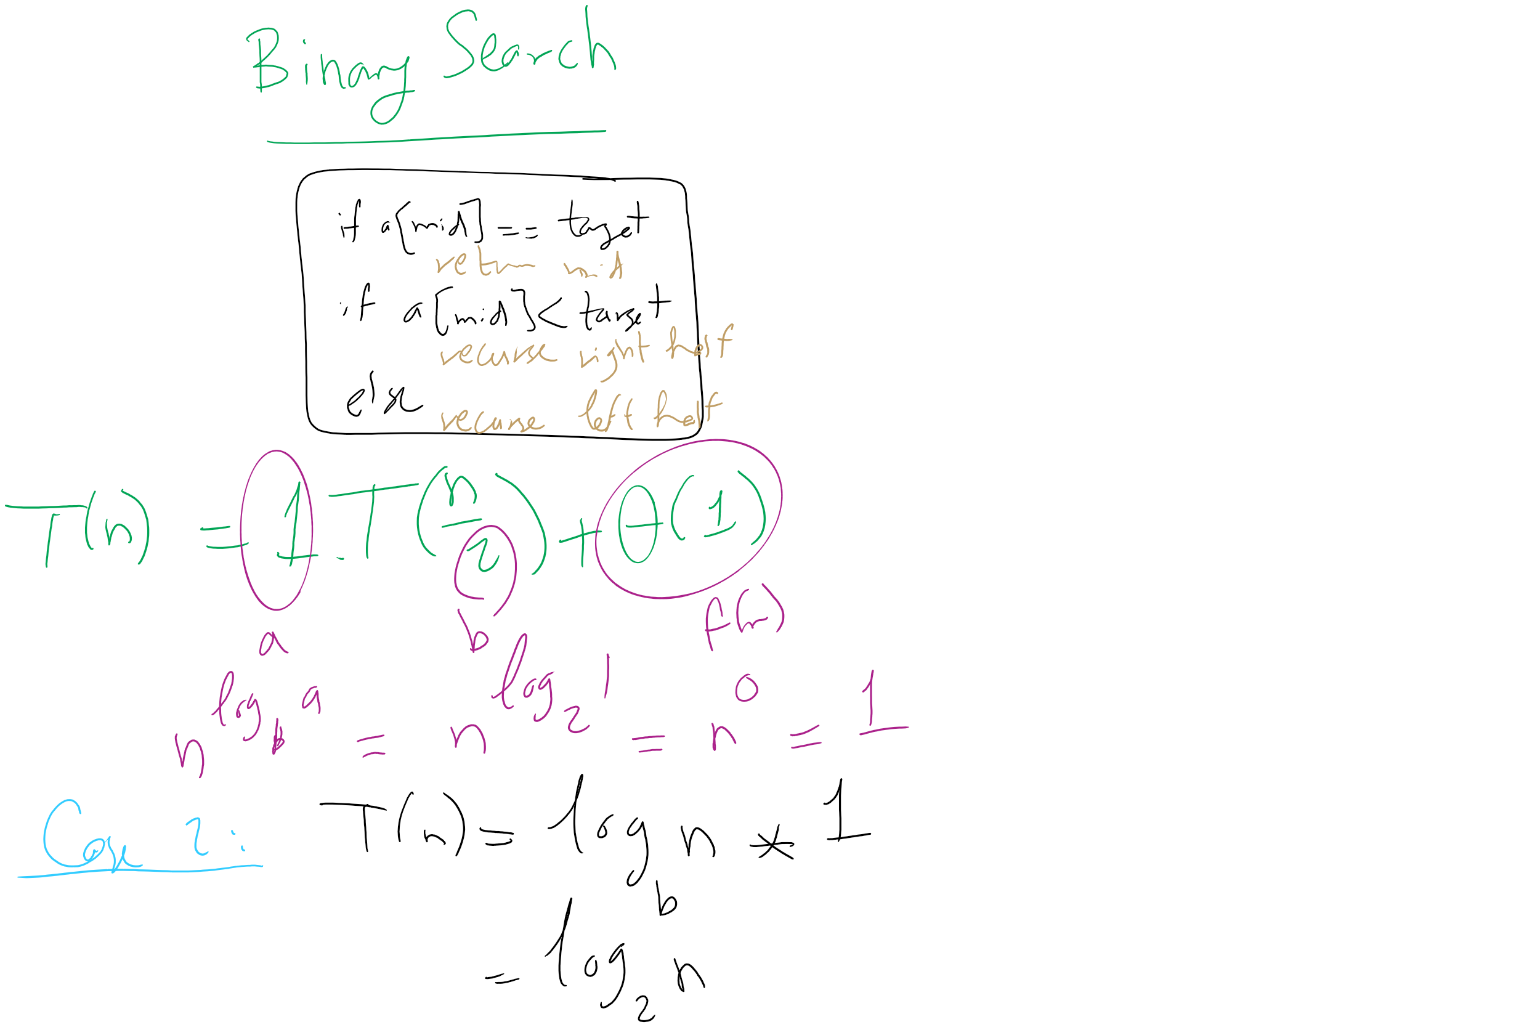
Binary Search Master Theorem Analysis

Slide 26
For our divide and conquer multiplication approach
T(n) = 4T(n/2) + Θ(n)
a = 4
b = 2
f(n) is Θ(n)
So...
n^{log_b(a)} = …
n^{lg 4} = n²
If f(n) is O(n^{log_b(a) - ε}):
T(n) is Θ(n^{log_b(a)})
If f(n) is Θ(n^{log_b(a)})
T(n) is Θ(n^{log_b(a)} lg n)
If f(n) is Ω(n^{log_b(a) + ε}) and (a * f(n/b) <= c * f(n)) for some c < 1:
T(n) is Θ(f(n))
Being Θ(n) means f(n) is polynomially smaller than n²
T(n) = Θ(n^{log_b(a)}) = Θ(n^{lg 4}) = Θ(n²)

Slide 27
@#$%^&*
Leaves us back where we started with the grade school algorithm…
Actually, the overhead of doing all of the dividing and conquering will make it slower than grade school

Slide 28
SO WHY EVEN BOTHER?
Let’s look for a smarter way to divide and conquer
Look at the recurrence relation again to see where we can improve our runtime:
T(n) = 4T(n/2) + Θ(n)
Can we reduce the amount of work done by the current call?
Can we reduce the number of subproblems?
Can we reduce the subproblem size?

Slide 29
Karatsuba’s algorithm
By reducing the number of recursive calls (subproblems), we can improve the runtime
x * y = 2^{n}x_{H}y_{H} + 2^{n/2}(x_{H}y_{L} + x_{L}y_{H}) + x_{L}y_{L}
M1
M2
M3
M4
We don’t actually need to do both M2 and M3
We just need the sum of M2 and M3
If we can find this sum using only 1 multiplication, we decrease the number of recursive calls and hence improve our runtime

Slide 30
Karatsuba craziness
M1 = x_{h}y_{h}; M2 = x_{h}y_{l}; M3 = x_{l}y_{h}; M4 = x_{l}y_{l};
The sum of all of them can be expressed as a single mult:
M1 + M2 + M3 + M4
= x_{h}y_{h} + x_{h}y_{l} + x_{l}y_{h} + x_{l}y_{l}
= (x_{h} + x_{l}) * (y_{h} + y_{l})
Lets call this single multiplication M5:
M5 = (x_{h} + x_{l}) * (y_{h} + y_{l}) = M1 + M2 + M3 + M4
Hence, M5 - M1 - M4 = M2 + M3
So: x * y = 2^{n}M1 + 2^{n/2}(M5 - M1 - M4) + M4
Only 3 multiplications required!
At the cost of 2 more additions, and 2 subtractions

Slide 31
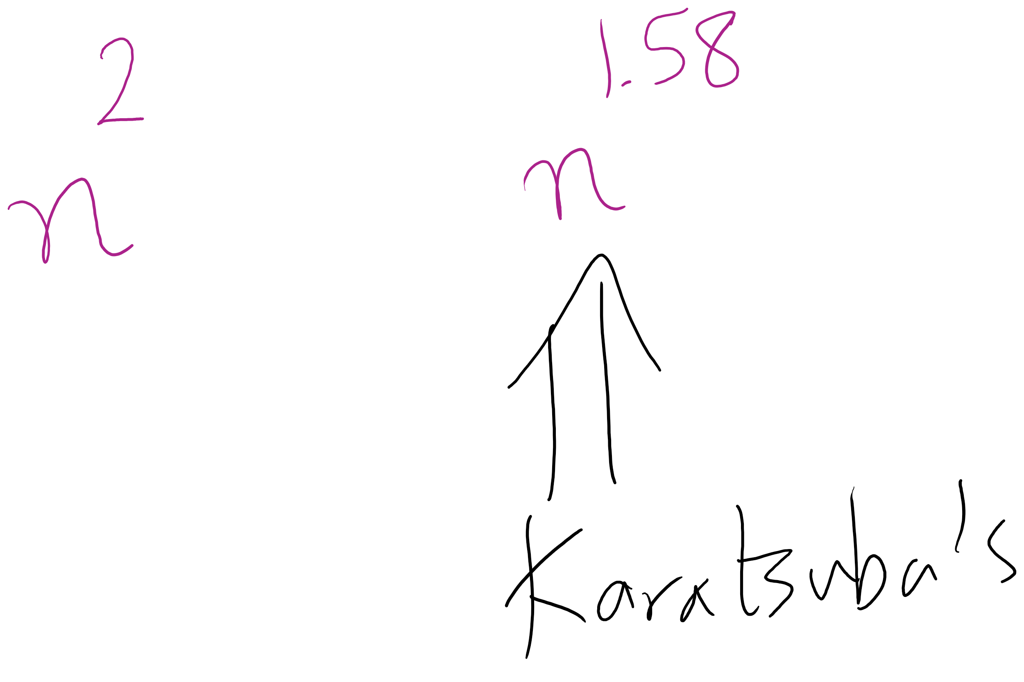
Karatsuba runtime
To get M5, we have to multiply (at most) n/2 + 1 bit ints
Asymptotically the same as our other recursive calls
Requires extra additions and subtractions…
But these are all Θ(n)
So, the recurrence relation for Karatsuba’s algorithm is:
T(n) = 3T(n/2) + Θ(n)
Which solves to be Θ(n^{lg 3})
Asymptotic improvement over grade school algorithm!
For large n, this will translate into practical improvement

Slide 32
Large integer multiplication in practice
Can use a hybrid algorithm of grade school for large operands, Karatsuba’s algorithm for VERY large operands
Why are we still bothering with grade school at all?
Notes:
Practical penalties of extra additions/subtractions
estimates say 320-640 bits is the tipping point for karatsubas

Slide 33
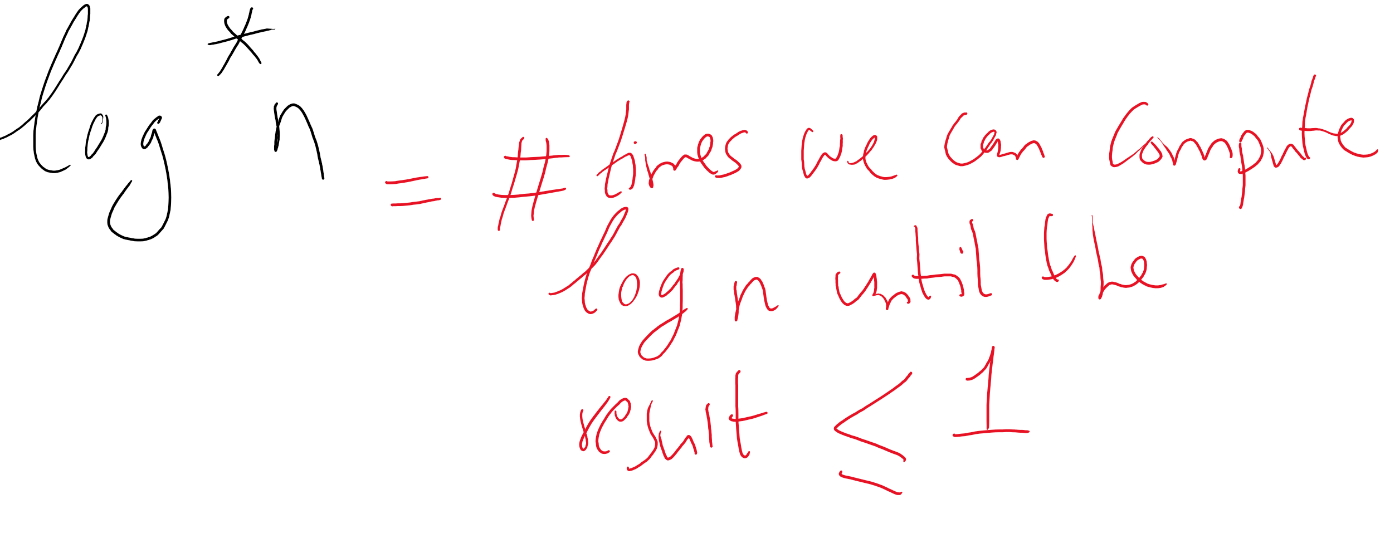
Is this the best we can do?
The Schönhage–Strassen algorithm
Uses Fast Fourier transforms to achieve better asymptotic runtime
O(n log n log log n)
Fastest asymptotic runtime known from 1971-2007
Required n to be astronomical to achieve practical improvements to runtime
Numbers beyond 2^{2^15} to 2^{2^17}
Fürer was able to achieve even better asymptotic runtime in 2007
n log n 2^{O(log^* n)}
No practical difference for realistic values of n
Notes:
The GNU Multi-Precision Library uses Schönhage–Strassen for 1728 to 7808 64-bit words
BigInteger will look over gradeschool, karatsuba, and toom3 (toom-cook variant)
There is a Java implementation of Schönhage–Strassen which uses it above 74,000 decimal digits

Slide 34
Exponentiation
x^{y}
Can easily compute with a simple algorithm:
ans = 1
i = y
while i > 0:
ans = ans * x
i--
Runtime?
Notes:
looking for θ(y) or "linear"

Slide 35
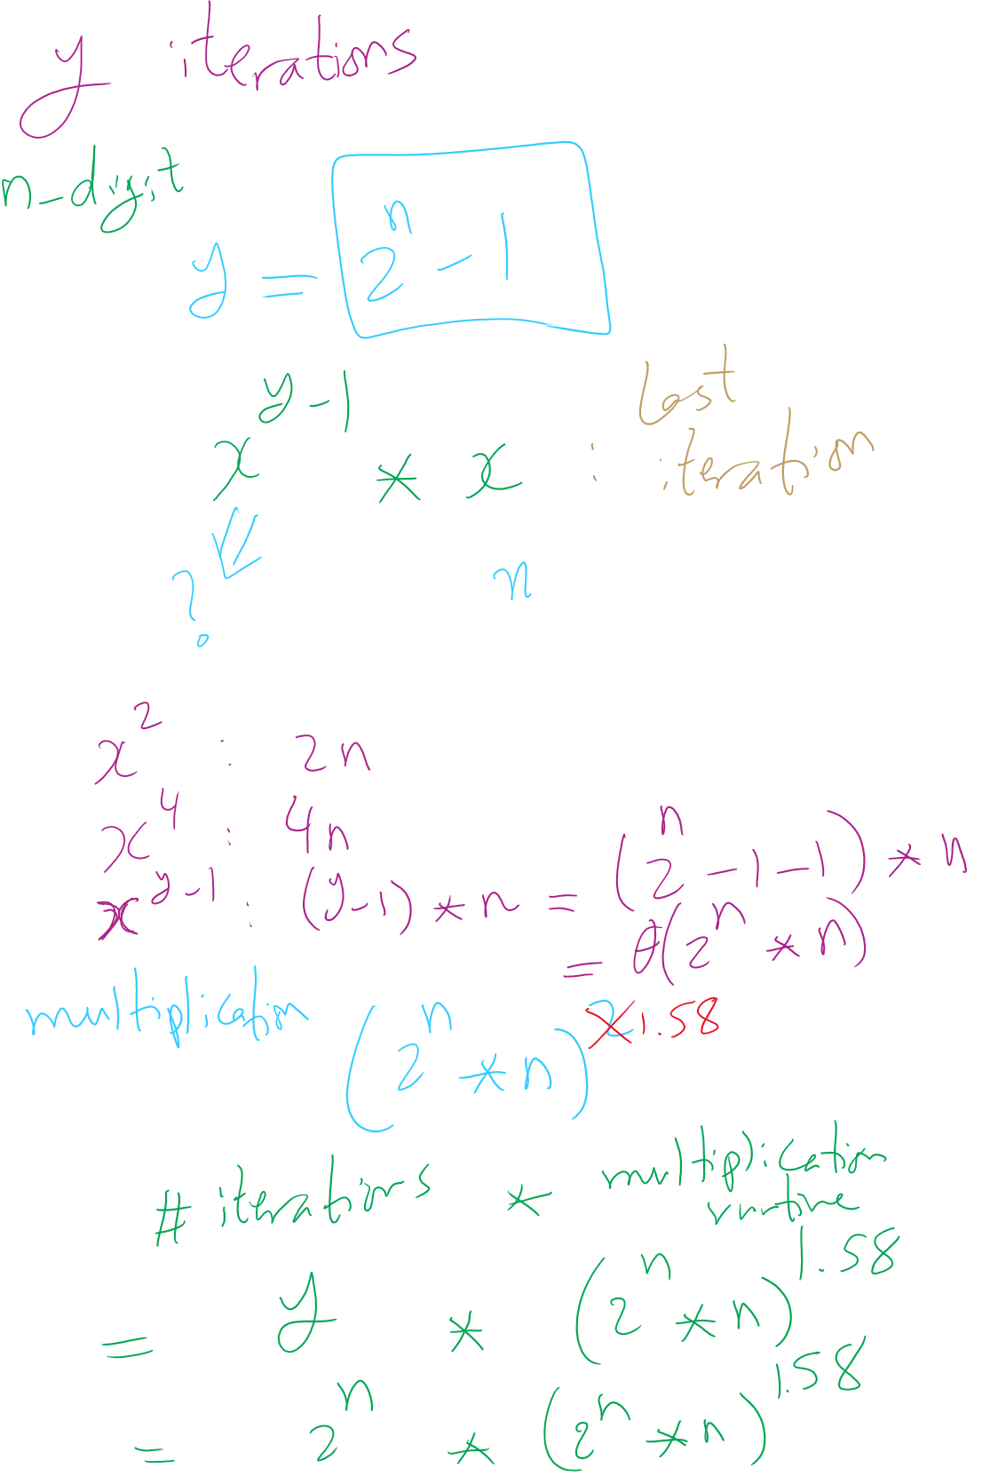
Runtime Analysis

Slide 36
Just like with multiplication, let's consider large integers...
Runtime = # of iterations * cost to multiply
Cost to multiply was covered in the last lecture
So how many iterations?
Single loop from 1 to y, so linear, right?
What is the size of our input?
n
The bitlength of y…
So, linear in the value of y…
But, increasing n by 1 doubles the number of iterations
Θ(2^{n})
Exponential in the bitlength of y
Notes:
What is the size of our input?
Cost to multiple using gradeschool: n^2

Slide 37
This is RIDICULOUSLY BAD
Assuming 512 bit operands, 2⁵¹²:
13407807929942597099574024998205846127479365820592393377723561443721764030073546976801874298166903427690031858186486050853753882811946569946433649006084096
Assuming we can do mults in 1 cycle…
Which we can’t as we learned last lecture
And further that these operations are completely parallelizable
16 4GHz cores = 64,000,000,000 cycles/second
(2⁵¹² / 64000000000) / (3600 * 24 * 365) =
6.64 * 10¹³⁵ years to compute

Slide 38
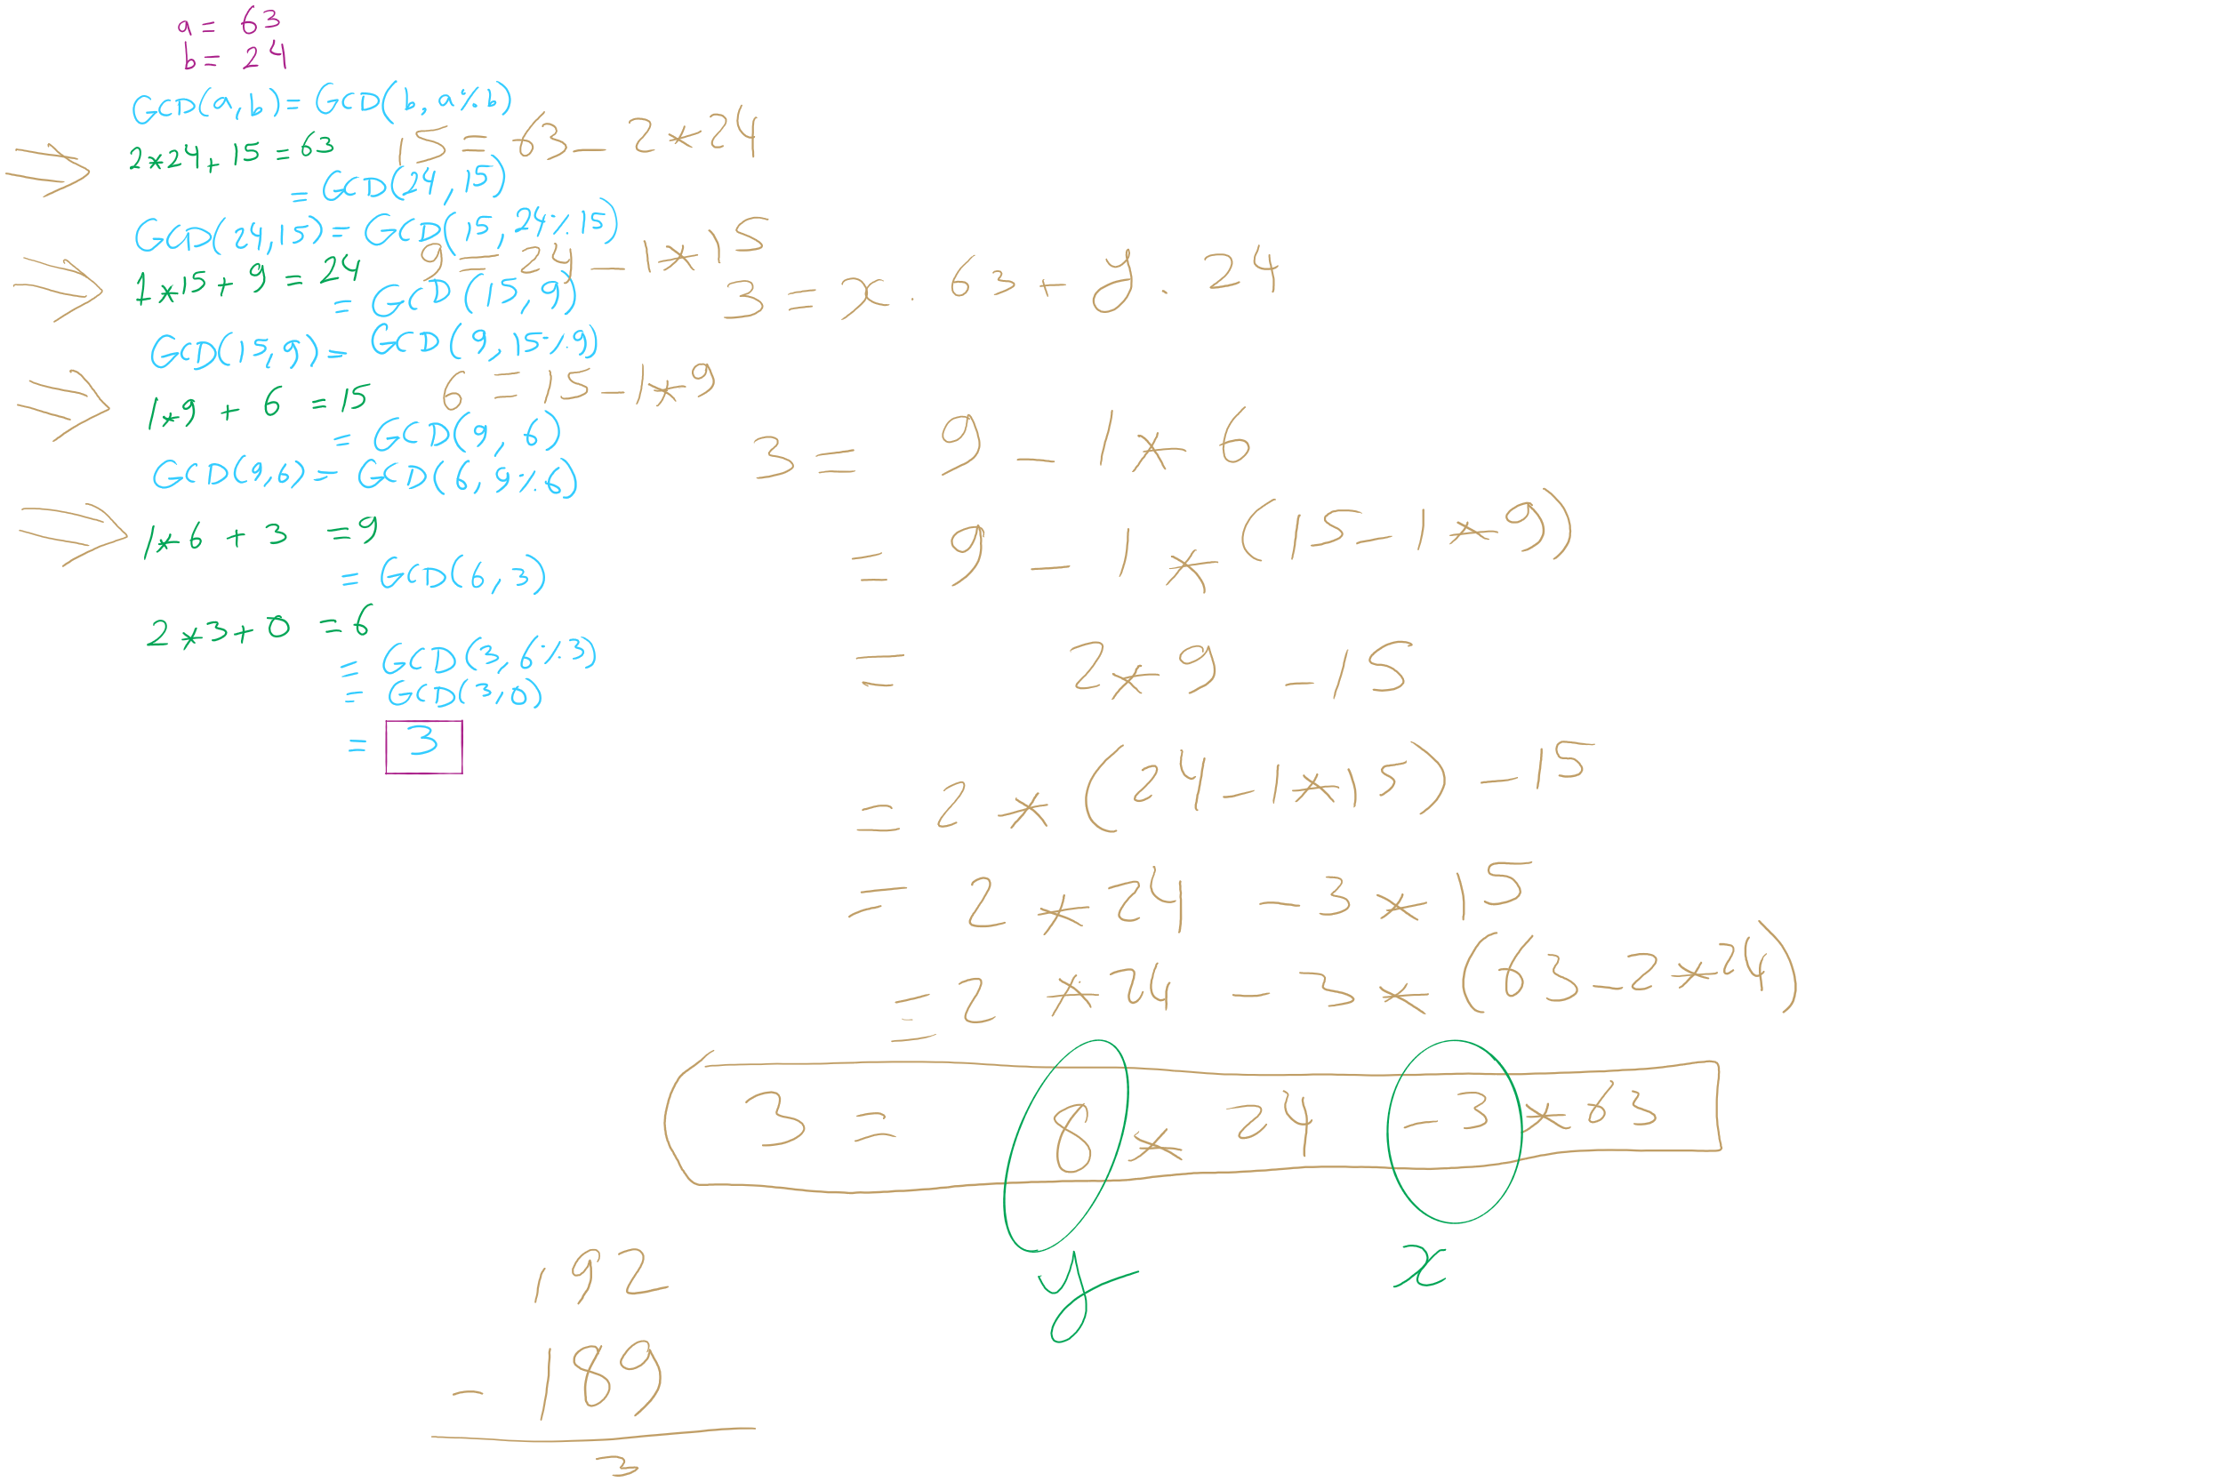
GCD/XGCD Example 1

Slide 39
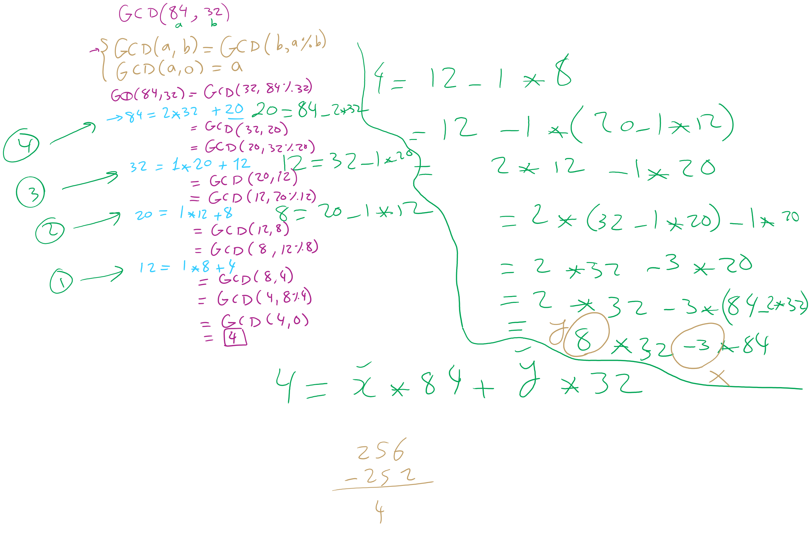
GCD/XGCD Example 2

Slide 40
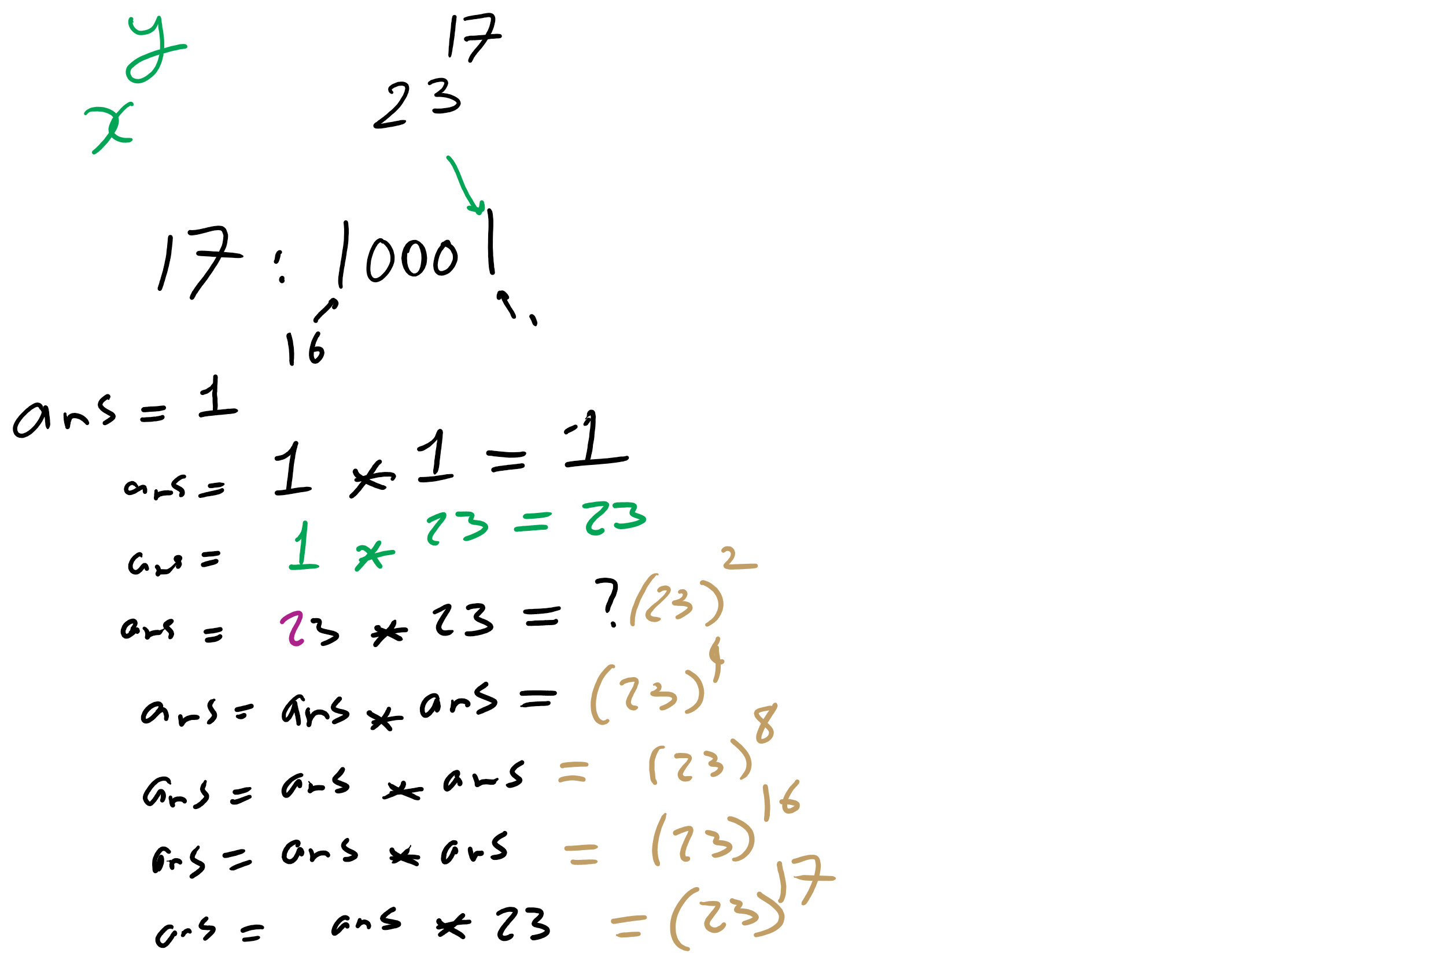
Bottom-up Exponentiation Example 1

Slide 41
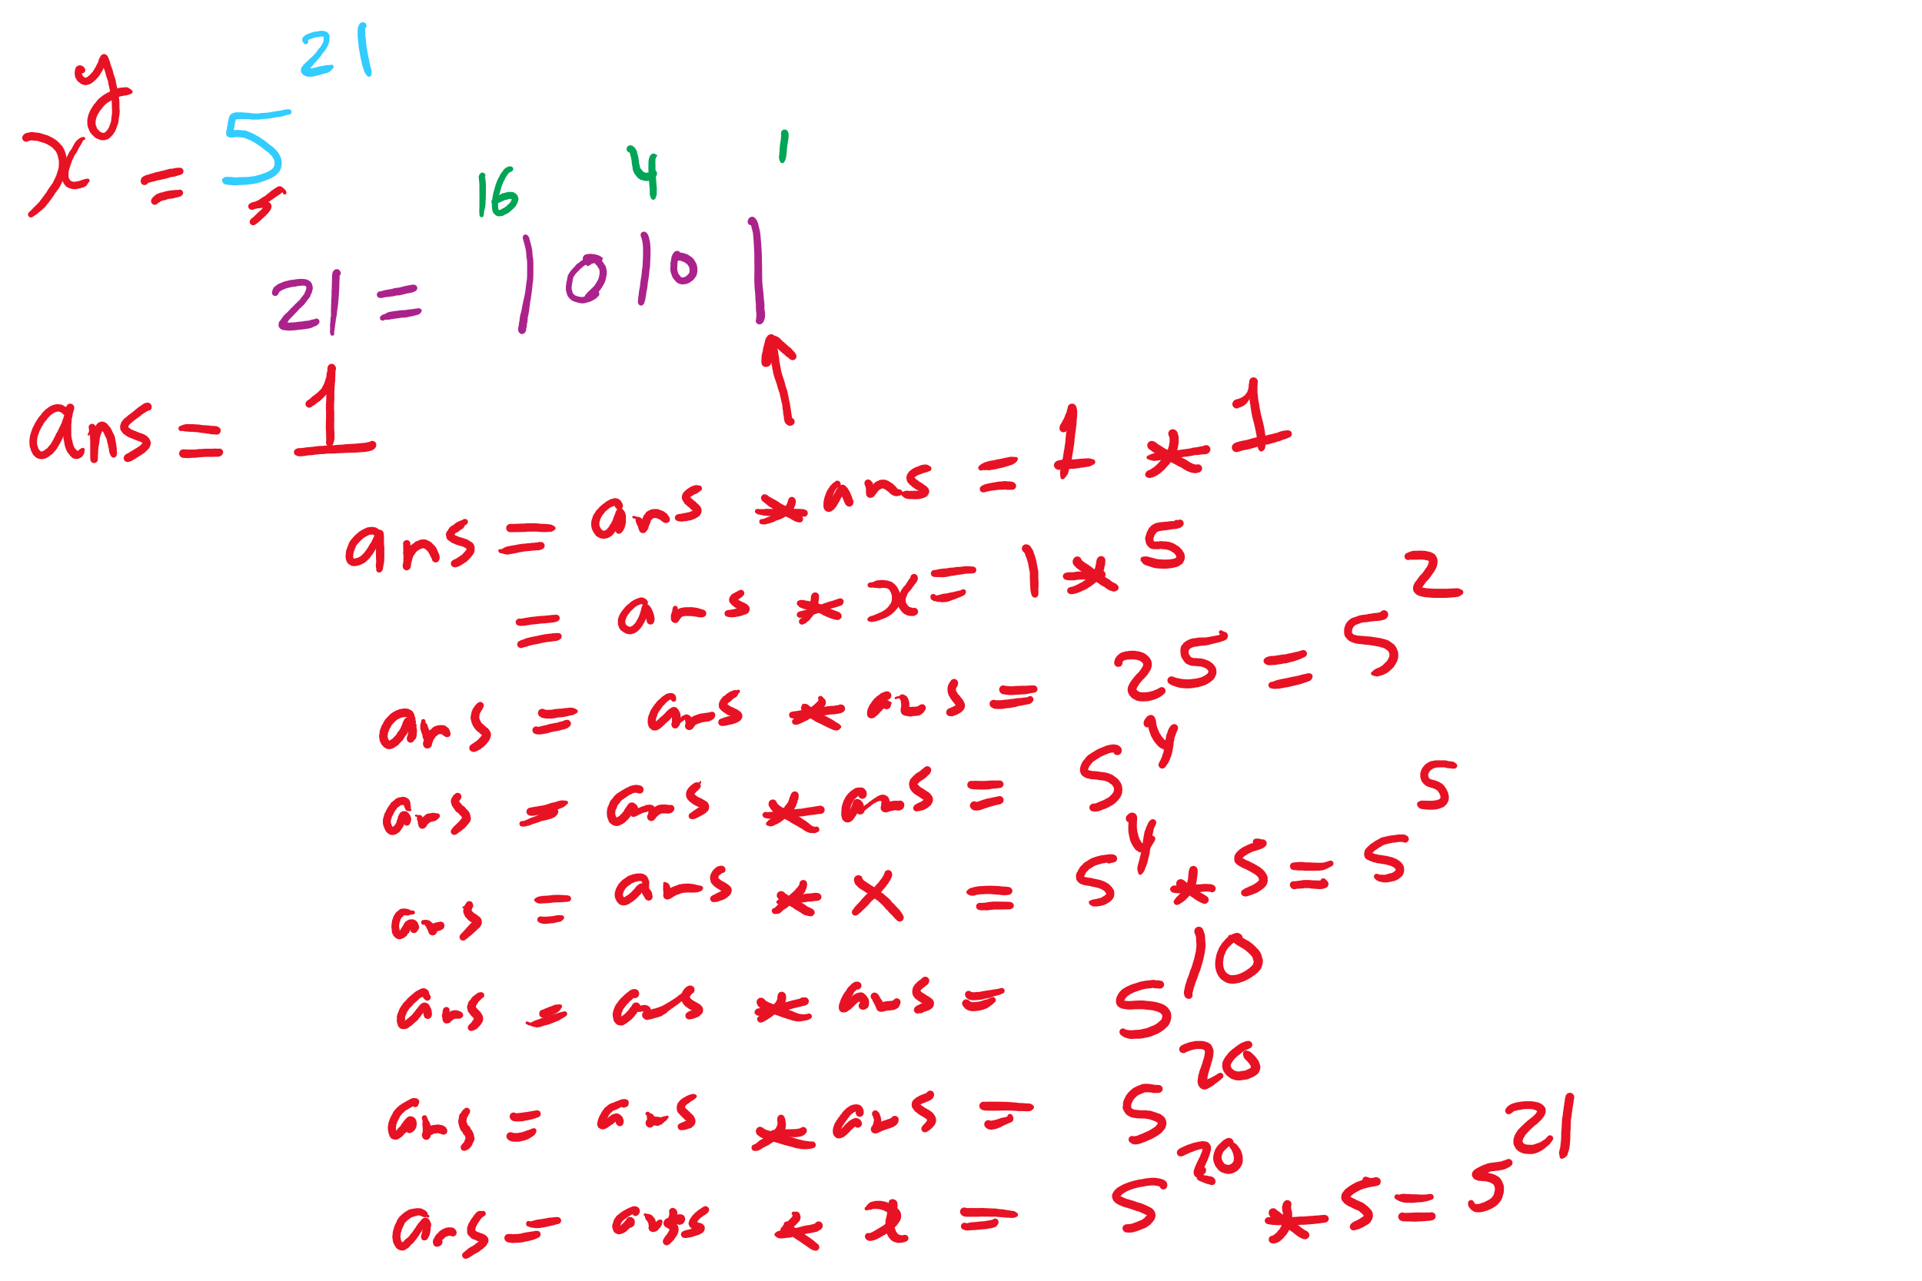
Bottom-up Exponentiation Example 2

Slide 42
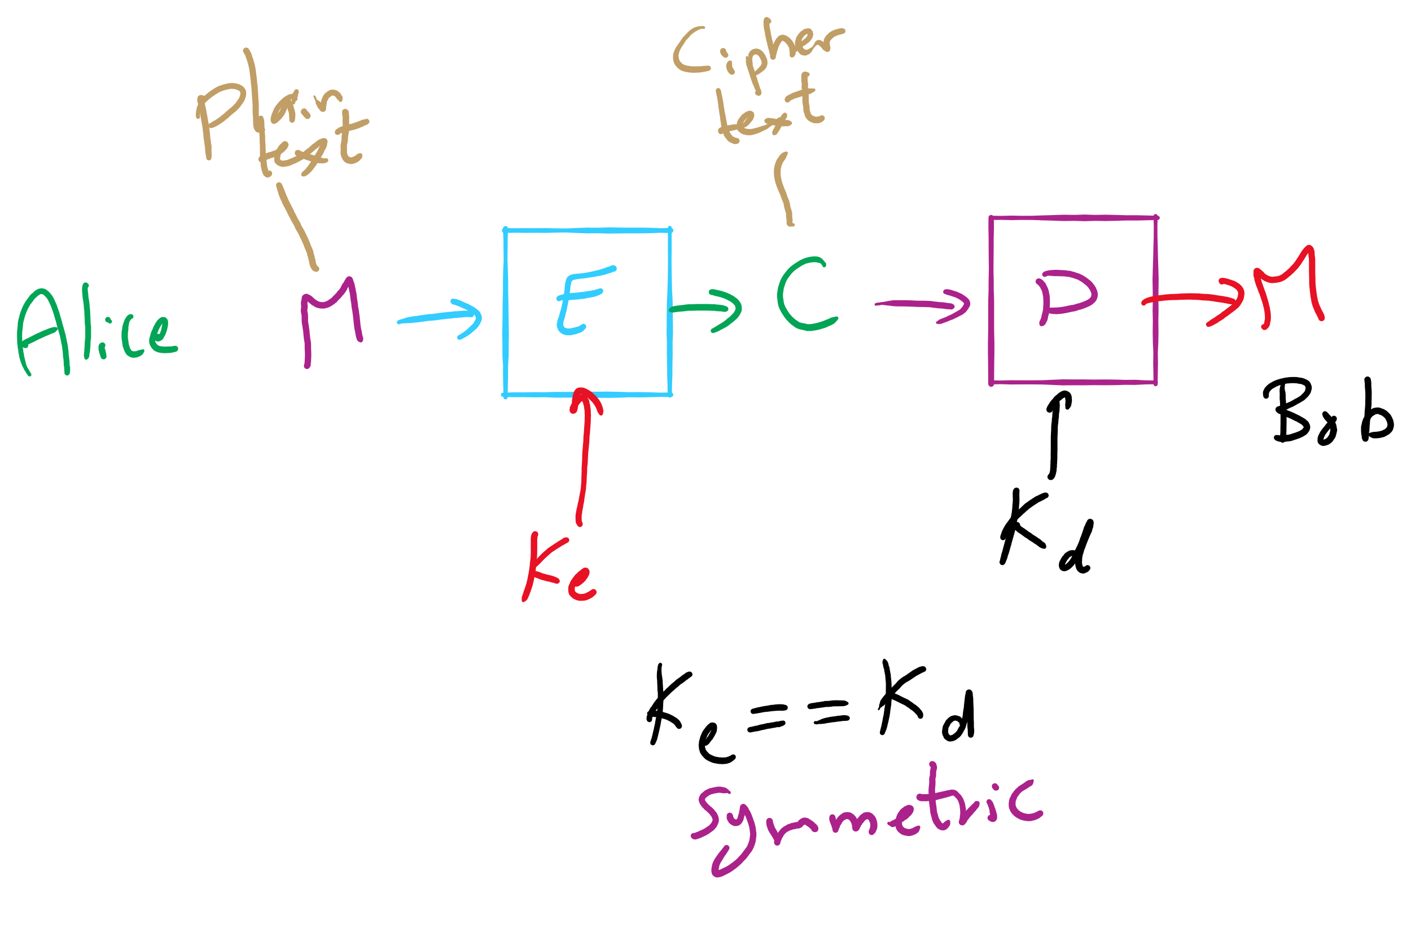
Encryption Model

Slide 43
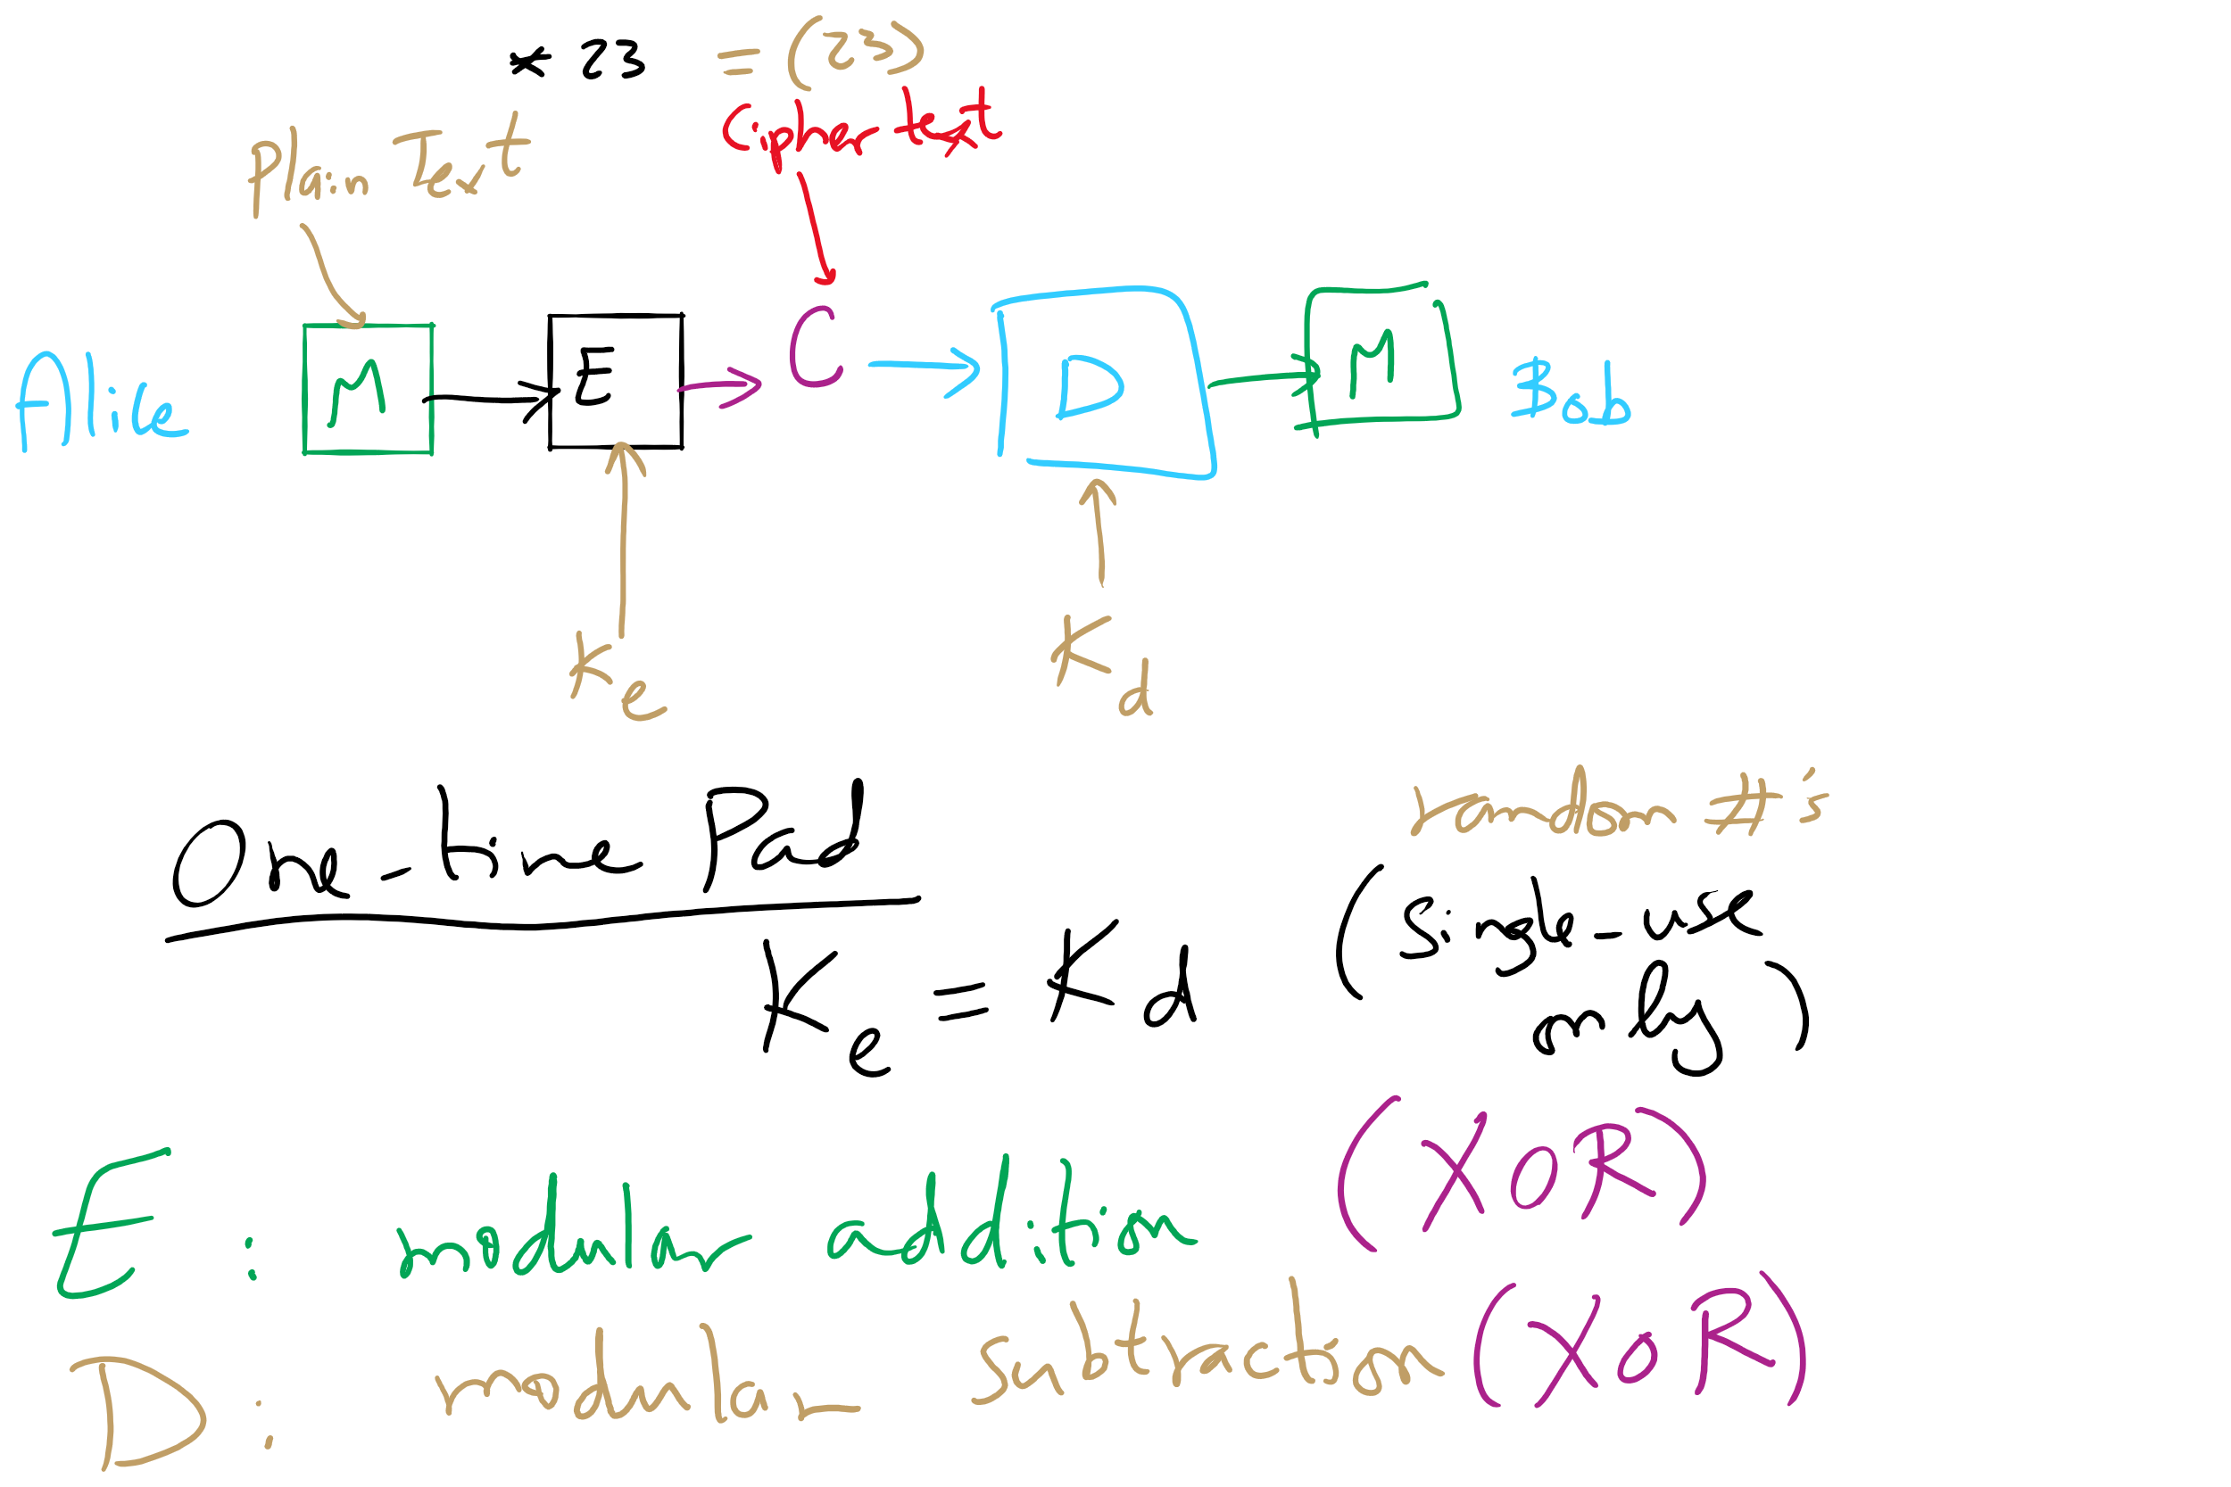
One-Time Pad

Slide 44
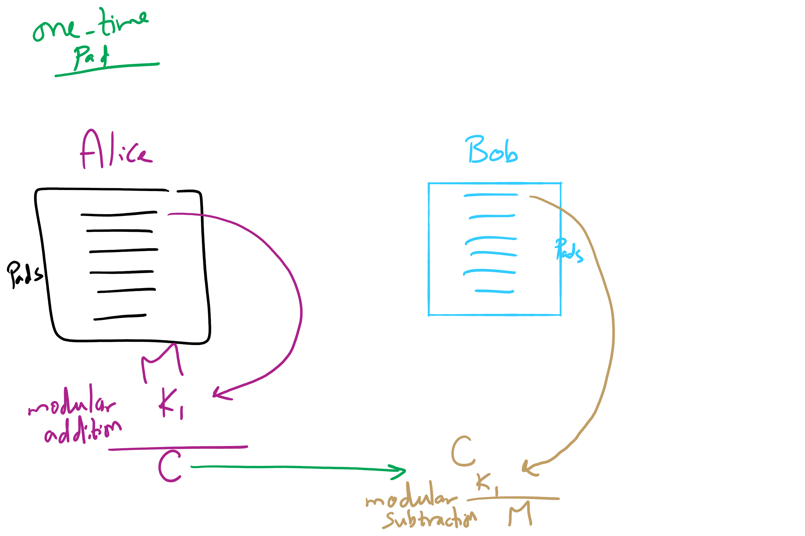
One-Time Pad

Slide 45
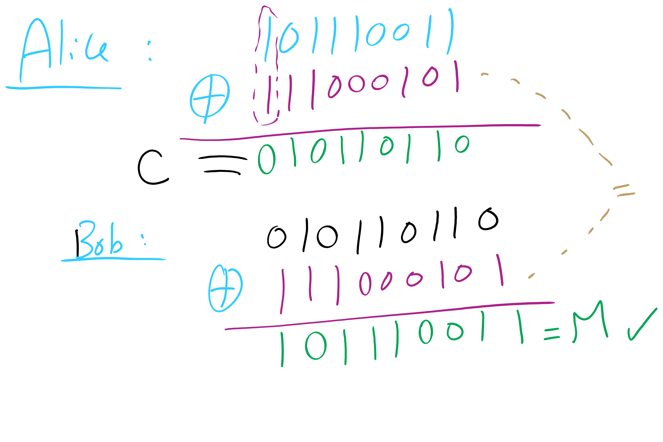
One-Time Pad Example 1

Slide 46
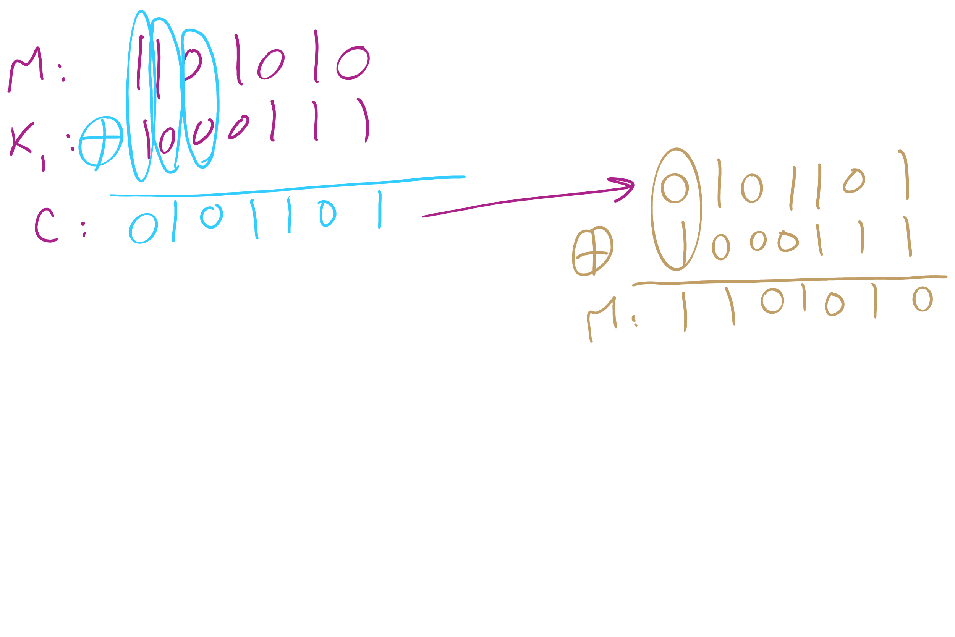
One-Time Pad Example 2

Slide 47
This Lecture
(Big)Integer Algorithms
RSA encryption
Dynamic Programming

Slide 48
Difficulties with one-time pads
Pads must be truly random
Both sender and receiver must have a matched list of pads in the appropriate order
Once you run out of pads, no more messages can be sent

Slide 49
Symmetric ciphers
Alice
M
Encrypt
C
Decrypt
M
Bob
K
K
E.g., DES, AES, Blowfish
Users share a single key
Numbers of a given bitlength (e.g., 128, 256)
Key is used to encrypt/decrypt many messages back and forth
Encryptions/decryptions will be fast
Typically linear in the size the input
Ciphertext should appear random
Best way to recover plaintext should be a brute force attack on the encryption key
Which we have shown to be infeasible for 128bit AES keys

Slide 50
Problems with symmetric ciphers
Alice and Bob have to both know the same key
How can you securely transmit the key from Alice to Bob?
Further, if Alice also wants to communicate with Charlie, her and Charlie will need to know the same key, a different key from the key Alice shares with Bob
Alice and Danielle will also have to share a different key…
etc.

Slide 51
Enter public-key encryption
Each user has their own pair of keys
A public key that can be revealed to anyone
A private key that only they should know
How does this solve our problem?
Public key can simply be published/advertised
Posted repositories of public keys
Added to an email signature
Each user is responsible only for their own keypair
Let's look at a public-key crypto scheme in detail...

Slide 52
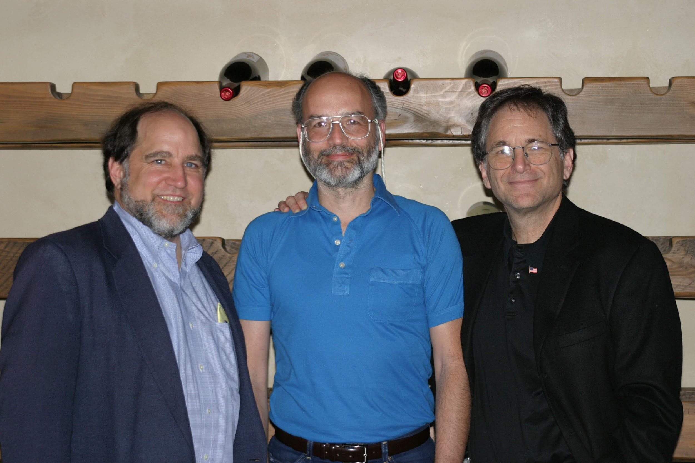
RSA
Notes:
Ronald Rivest, Adi Shamir, Leonard Adleman

Slide 53
RSA Cryptosystem in-depth
What are RSA keypairs?
How messages encrypted?
How are messages decrypted?
How are keys generated?
Why is it secure?

Slide 54
RSA keypairs
Public key is two numbers, which we will call n and e
Private key is a single number we will call d
The length of n in bits is the key length
I.e., 2048 bit RSA keys will have a 2048 bit n value
Note that "n" will be used to indicate the RSA public key component for our discussion of RSA...

Slide 55
Encryption
Say Alice wants to send a message to Bob
Looks up Bob’s public key
Convert the message into an integer: m
Compute the ciphertext c as:
c = m^{e} (mod n)
Send c to Bob

Slide 56
Decryption
Bob can simply:
Compute m as:
m = c^{d} (mod n)
Convert m into Alice’s message

Slide 57


Slide 58
n, e, and d need to be carefully generated
Choose two prime numbers p and q
Compute n = p * q
Compute φ(n)
φ(n) = φ(p) * φ(q) = (p - 1) * (q - 1)
Choose e such that
1 < e < φ(n)
GCD(e, φ(n)) = 1
I.e., e and φ(n) are co-prime
Determine d as d = e⁻¹ mod(φ(n))

Slide 59
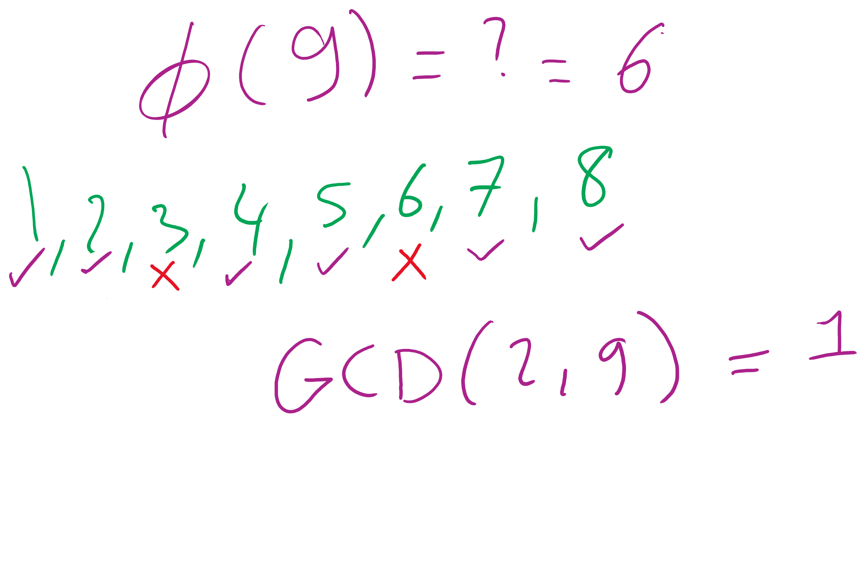
What the φ?
Here, we mean φ to be Euler’s totient
φ(n) is a count of the integers < n that are co-prime to n
I.e., how many k are there such that:
1 <= k <= n AND GCD(n, k) = 1
p and q are prime..
Hence, φ(p) = p - 1 and φ(q) = q -1
Further, φ is multiplicative
Since p and q are prime, they are co-prime, so
φ(p) * φ(q) = φ(p * q) = φ(n)
I won’t detail the proof here...

Slide 60
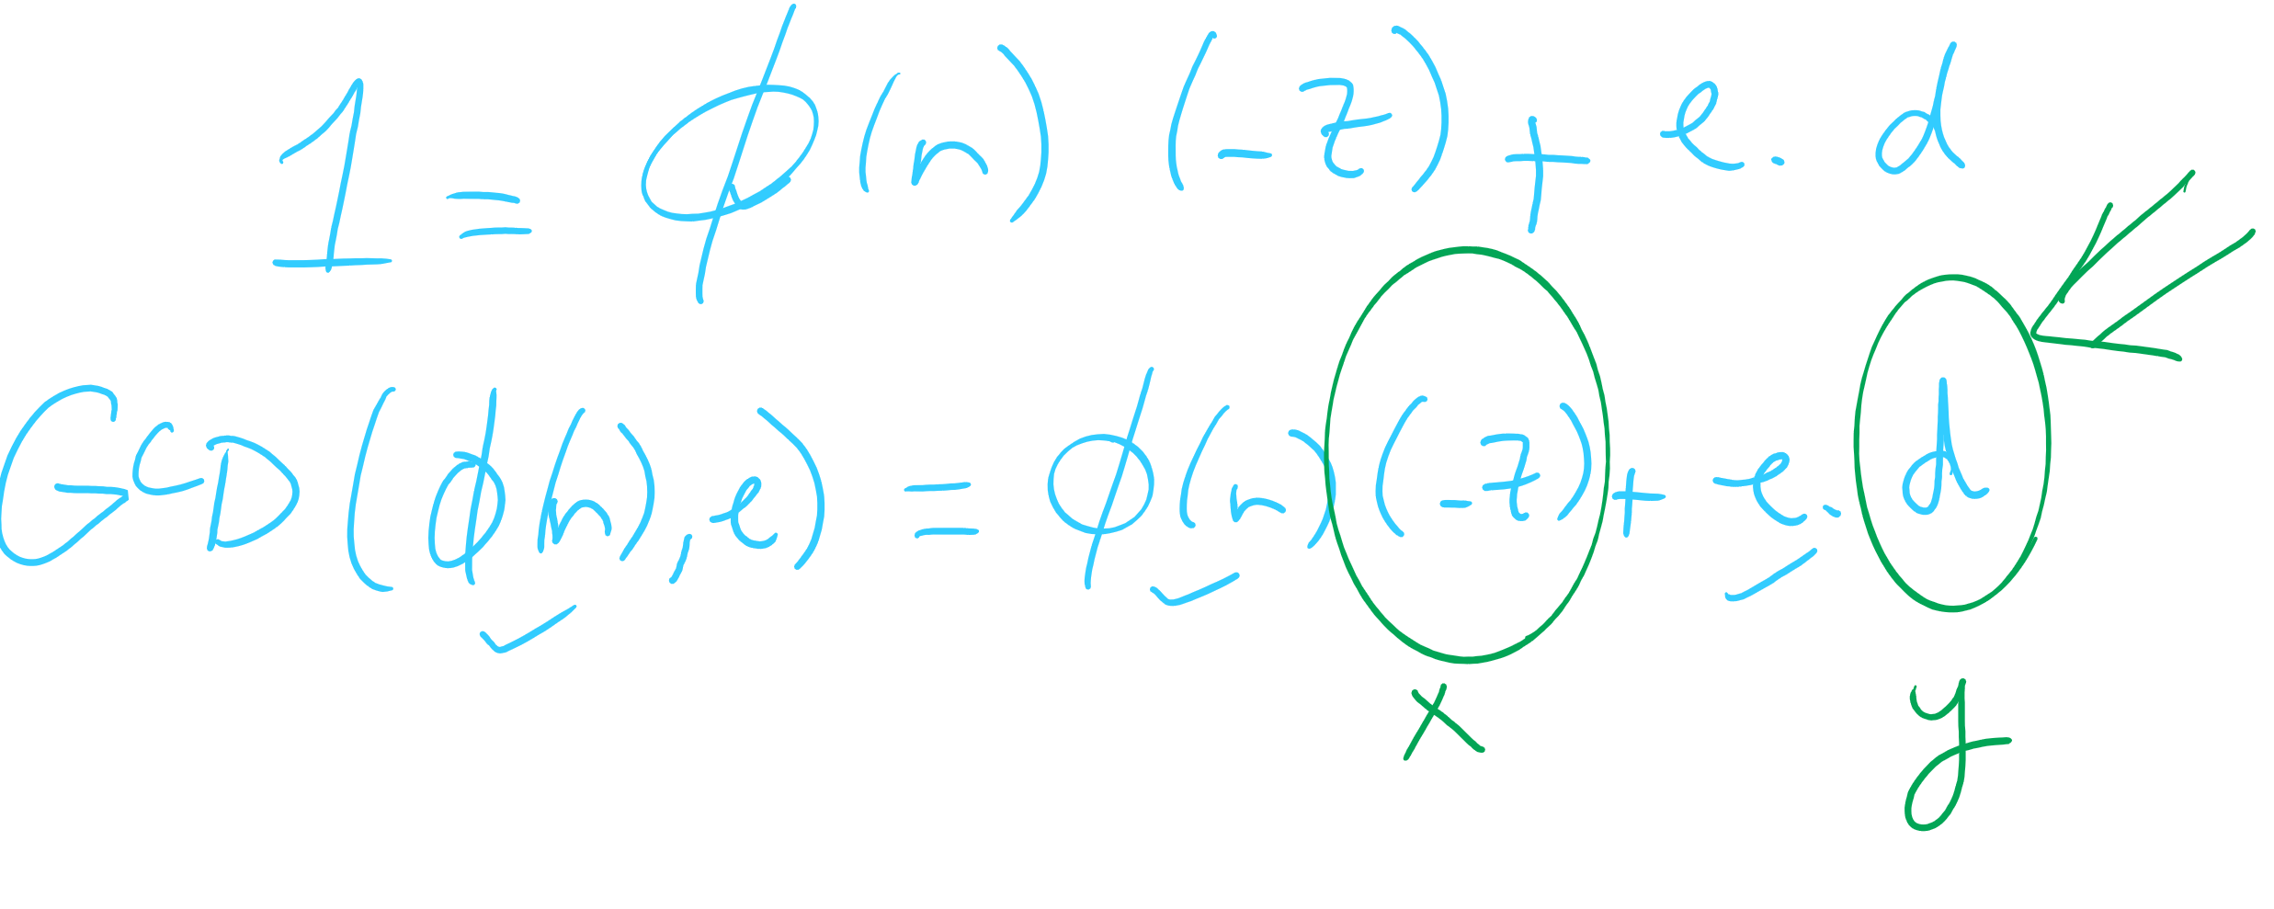
OK, now what about multiplicative inverses mod φ(n)?
d = e⁻¹ mod(φ(n))
Means that d = 1/e mod(φ(n))
Means that e * d = 1 (mod φ(n))
Now, this can be equivalently stated as e * d = z * φ(n) + 1
For some z
Can further restate this as: e * d - z * φ(n) = 1
Or similarly: 1 = φ(n) * (-z) + e * d
How can we solve this?
Hint: recall that we know GCD(φ(n), e) = 1

Slide 61
Use extended Euclidean algorithm!
GCD(a, b) = i = ax + by
Let:
a = φ(n)
b = e
x = -z
y = d
i = 1
GCD(φ(n), e) = 1 = φ(n) * (-z) + e * d
We can compute d in linear time!

Slide 62
RSA keypair example notes
p and q must be prime
n = p * q
φ(n) = (p - 1) * (q - 1)
Choose e such that
1 < e < φ(n) and GCD(e, φ(n)) = 1
Solve XGCD(φ(n), e) = 1 = φ(n) * (-z) + e * d
Compute the ciphertext c as:
c = m^{e} (mod n)
Recover m as:
m = c^{d} (mod n)
Notes:
Ready (( … )**13) % 77 in a python prompt
Advertise public key (n=77, e=37)
Request an encrypted message
What does the mod n mean for possible messages to encrypt??
Show result
Step through key gen process
p = 7, q = 11
n = 77
φ(n) = 60
select e to be 37
co-prime to 60
XGCD(60, 37) = 1 = 60 * -8 + 37 * 13
d = 13

Slide 63
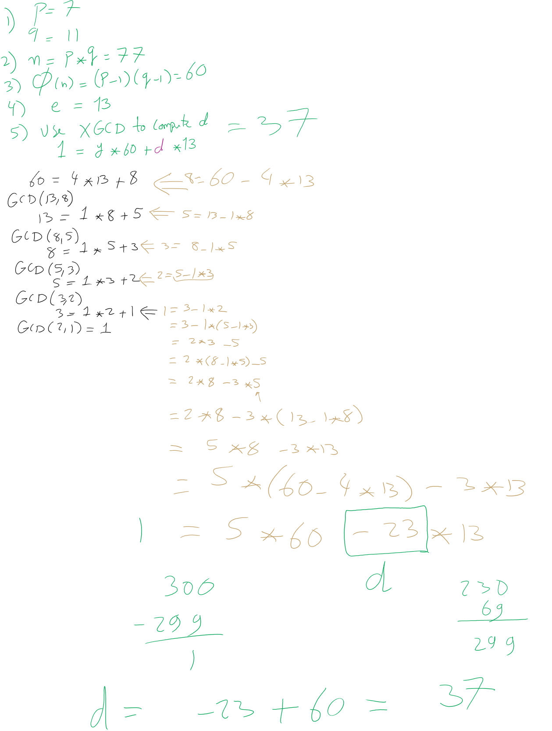
RSA Example 1

Slide 64
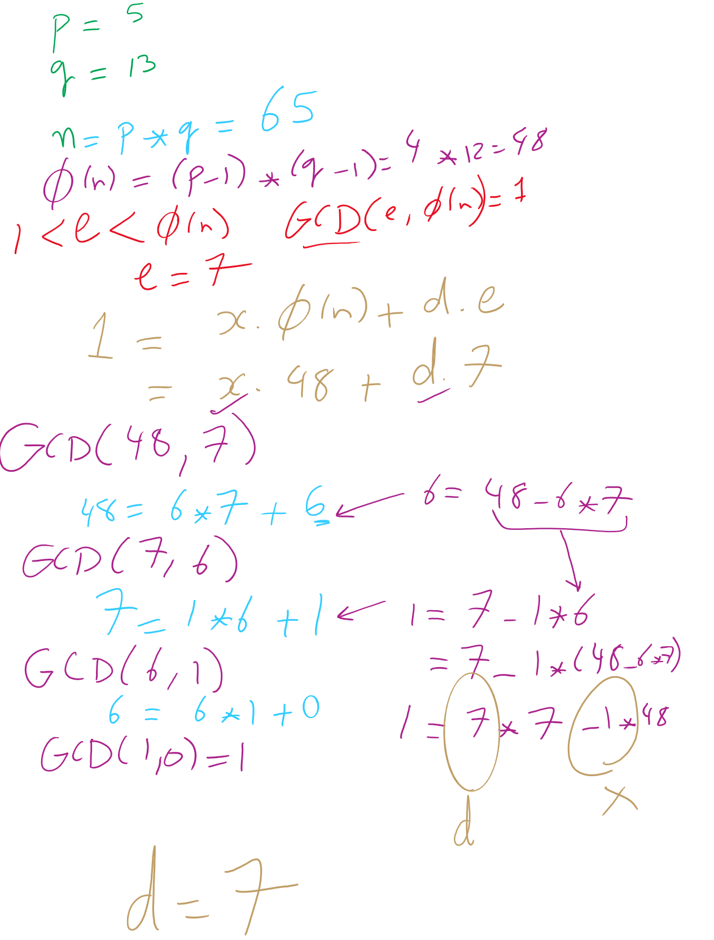
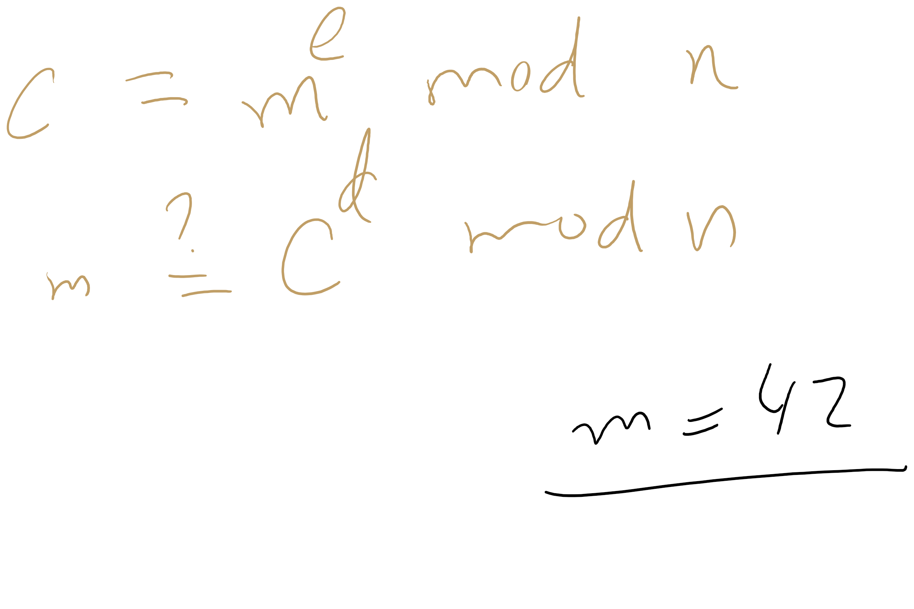
RSA Example 2

Slide 65
OK, but how does m^{ed} = m mod n?
Feel free to look up the proof using Fermat’s little theorem
Knowing this proof is NOT required for the course
Knowing how to generate RSA keys and encrypt/decrypt IS
For this course, we’ll settle with our example showing that it does work

Slide 66
Why is RSA secure?
4 avenues of attack on the math of RSA were identified in the original paper:
Factoring n to find p and q
Determining φ(n) without factoring n
Determining d without factoring n or learning φ(n)
Learning to take e^{th} roots modulo n

Slide 67
Factoring n
To the best of our knowledge, this is hard
A 768 bit RSA key was factored one time using the best currently known algorithm
Took 1500 CPU years
2 years of real time on hundreds of computers
Hence, large keys are pretty safe
2048 bit keys are a pretty good bet for now

Slide 68
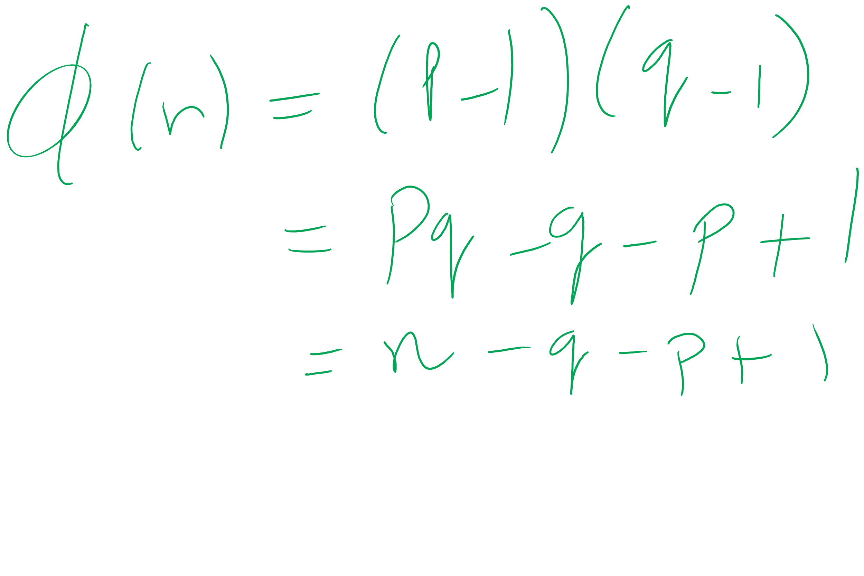
What about determining φ(n) without factoring n?
Would allow us to easily compute d because ed = 1 mod φ(n)
Note:
φ(n) = n - p - q + 1
φ(n) = n - (p + q) + 1
(p + q) = n + 1- φ(n)
(p + q) - (p - q) = 2q
Now we just need (p - q)...
(p - q)² = p² - 2pq + q²
(p - q)² = p² + 2pq + q² - 4pq
(p - q)² = (p + q)² - 4pq
(p - q)² = (p + q)² - 4n
(p - q) = √((p + q)² - 4n)
If we can figure out φ(n) efficiently, we could factor n efficiently!

Slide 69
Determining d without factoring n or learning φ(n)?
If we know, d, we can get a multiple of φ(n)
ed = 1 mod φ(n)
ed = kφ(n) + 1
For some k
ed - 1 = kφ(n)
It has been shown that n can be efficiently factored using any multiple of φ(n)
Hence, this would provide another efficient solution to factoring!

Slide 70
Learning to take e^{th} roots modulo n
Conjecture was made in 1978 that breaking RSA would yield an efficient factoring algorithm
To date, it has been not been proven or disproven

Slide 71
This all leads to the following conclusion
Odds are that breaking RSA efficiently implies that factoring can be done efficiently.
Since factoring is probably hard, RSA is probably safe to use.

Slide 72
Implementation concerns
Encryption/decryption:
How can we perform efficient exponentiations?
Key generation:
We can do multiplication, XGCD for large integers
What about finding large prime numbers?

Slide 73
Efficient exponentiation for RSA
Does this solve our problems?
ans = 1
foreach bit in y:
ans = (ans² mod n)
if bit == 1:
ans = (ans * x mod n)
ans = 1
foreach bit in y:
ans = ans²
if bit == 1:
ans = ans * x
How can we improve runtime for RSA exponentiations?
Don’t actually need x^{y}
Just need (x^{y} mod n)

